Slide 1
A Users Guide to Floristic Quality Assessment
Greg Spyreas
Illinois Natural History Survey
Notes:
Current state of understanding, research, as well as common mistakes by users
Will be some time before all the data shown here are published, but it will be eventually.

Slide 2
Outline
Intro Floristic Quality Assessment (FQA)
Philosophy, Definitions, & Terms
species Conservatism & Floristic Quality
Sampling & Methods
Comparing site scores & Analysis
Do’s & Don’ts

Slide 3
Floristic Quality Assessment (FQA)
Every plant in a state 0-10, species Conservatism
Coefficients of Conservatism (C-values)
Expert botanists panel
Non-natives 0 or ignored
Mean Conservatism (Mean C)
3.5 - 4.5
Floristic Quality Index (FQI) = mean C * √N
35 – 45
Anthropogenic disturbance/degradation -> Conservation value
Notes:
Here’s how FQA woks
Species Conservatism

Slide 4
Floristic Quality Assessment (FQA)
Every plant in a state 0-10
Coefficients of Conservatism (C-values)
Mean Conservatism (Mean C)
3.5 - 4.5
Floristic Quality Index (FQI) = mean C * √N
35 – 45
Anthropogenic disturbance/degradation -> Conservation value
Notes:
2 FQA metrics
Using the C-values from the species at a site to measure its Floristic Quality
Notice that Mean C is the average and that FQI incorporates species richness
Displayed values represent pretty good scores

Slide 5
Floristic Quality Assessment (FQA)
Every plant in a state 0-10
Coefficients of Conservatism (C-values)
Mean Conservatism (Mean C)
3.5 - 4.5
Floristic Quality Index (FQI) = mean C * √N
35 – 45
Anthropogenic disturbance-> Biological degradation -> Conservation value
Notes:
Make a plant species list & generate 2 simple FQA metric values
With these values you can instantly rank/measure/quantify a site’s Floristic Quality
Remember that Floristic Quality is SOLELY determined by the Human Disturbance legacy of the site --> which leads to biological degradation (elimination Conservative species) = because high Floristic Quality habitats are very rare, a site’s FQA values may also be used as a proxy for its relative conservation value in a region

Slide 6
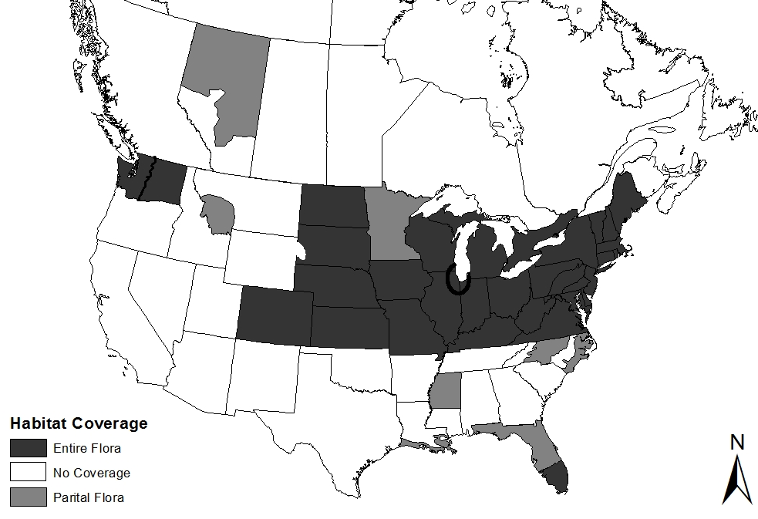
Spyreas, in prep
Notes:
States/Regions with C-values assigned to their all or part of their floras
Recent Update: Southeast U.S. from the Atlantic to the Mississippi River is now covered
Including areas of China, Italy, and Pakistan
Needing only a plant species list, FQA’s simplicity and ability to measure so much information with a single measure, Along with rise in geographic coverage shown here has led to a meteoric rise in numbers and types of uses of FQA

Slide 7
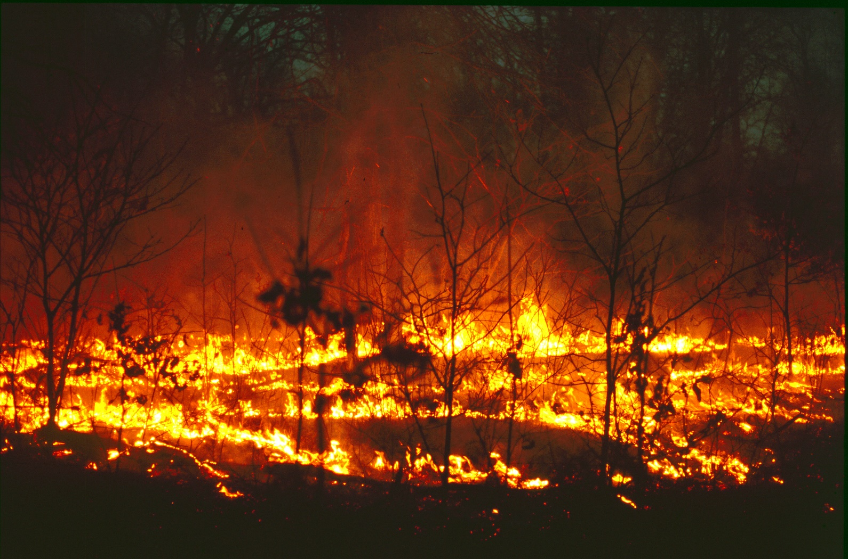
Use of FQA
Identify & rank natural areas purchase or protection
Management & restoration
Legal & regulatory (Federal, State, County, Municipal, etc.)
Research
Notes:
Identify natural areas
Created as an applied conservation metric whose initial use was for a quick objective way to determine an areas natural quality and value.
Designation of nature preserves by the state, counties etc – numbers often go right into the formal/legal nomination document and are use as evidence
TNC and others use to assess habitat parcels they are interested in protecting
Management
Tracking and test for effects of Management & Restoration over time
Fire-- Seed sowing– hydrology-- deer exclosures– grazing-- exotic species, etc
Regulatory
The unquenchable desire by policy makers, politicians, agencies, non-scientists for simple single metrics has meant that it is picked up for regulatory and government agencies often legally codified. These are now some of the uses with the most important implications over the most acres.
Conservation & Ecology Research
Large scale multi habitat analyses of determine the biological effects of exotic species invasion,
landscape ecology questions (e.g., Lopez & Fennessy 2002; Cohen, Carstenn & Lane 2004; Balcombe et al. 2005; Matthews et al. 2005; Bowles & Jones 2006; Jog et al. 2006; Mack 2006; Miller & Wardrop 2006; Miller et al. 2006; Spyreas & Matthews 2006; Mack 2007; Johnston et al. 2008; Mack et al. 2008; Mack 2009; Spyreas et al. 2010).
restoration success and failure (e.g., Mushet, Euliss & Shaffer 2002; Balcombe et al. 2005; Matthews et al. 2009),
causes and patterns in long-term degradation to remnant habitats (Nichols 2001; Milbauer & Leach 2007; Kraszewski & Waller 2008; Rooney & Leach 2010; Smart et al. 2011).
research

Slide 8
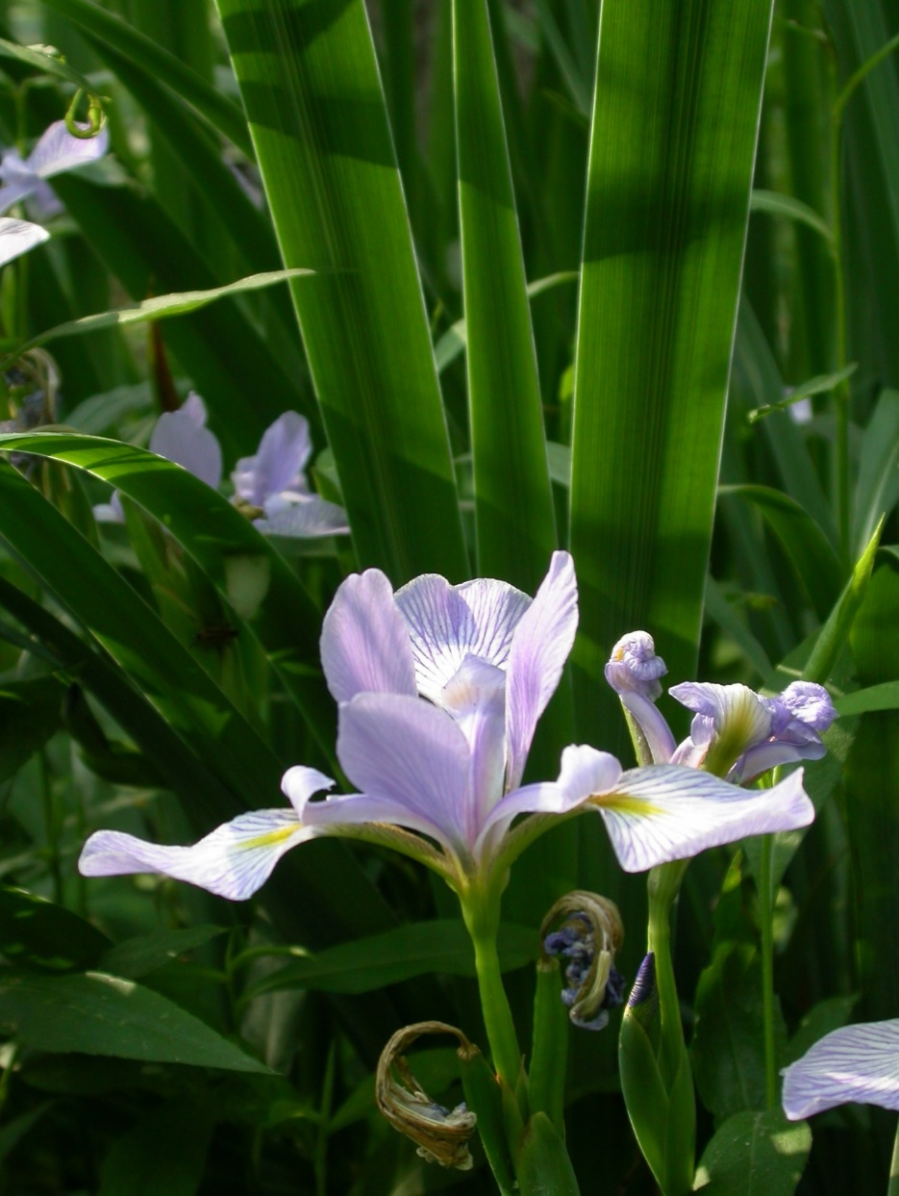
Definitions = DANGER!!
species “Conservatism”
site “Floristic Quality”
Notes:
FQA Definitions that are floating around out there (often in published literature) are often problematic and error prone and have created confusion
2 commonly mis-defined-concepts: species Conservatism and site Floristic Quality

Slide 9
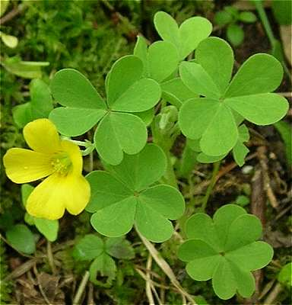
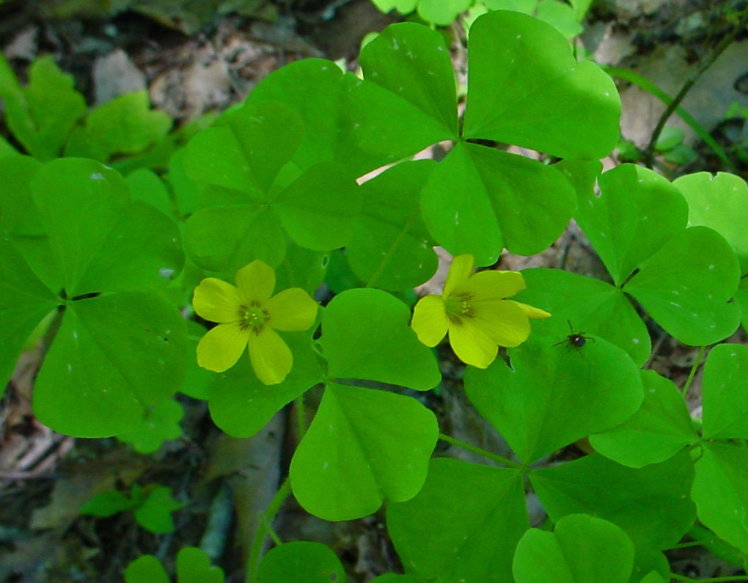
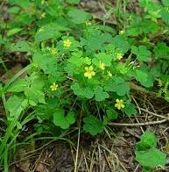
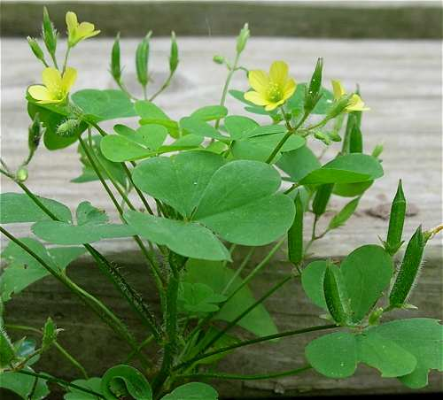
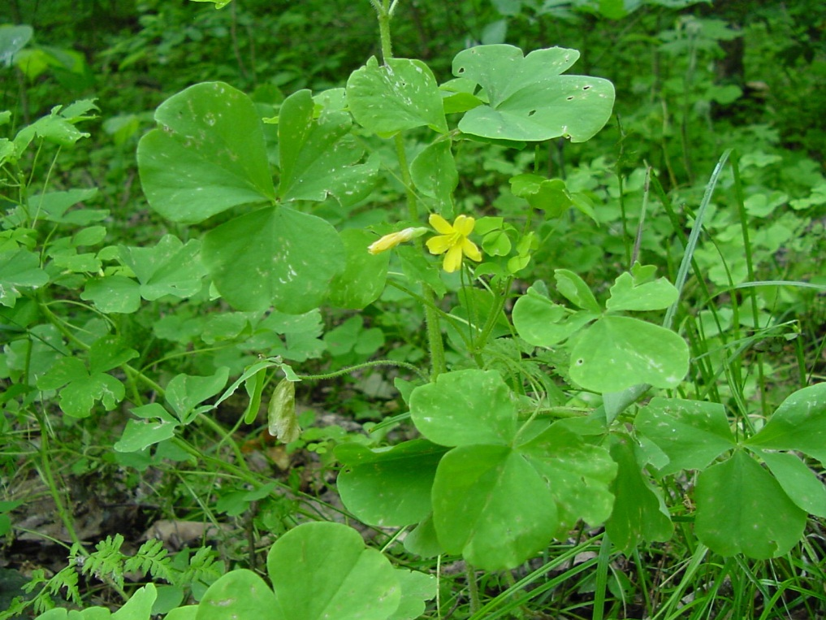
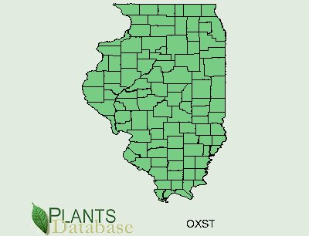
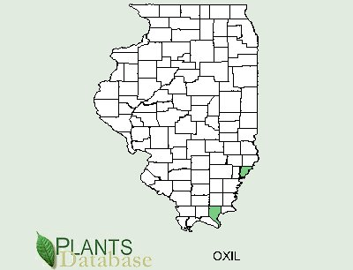
Oxalis stricta
Common yellow sorrel
Everywhere
C = 0
Oxalis illinoensis
Illinois wood sorrel
Rich mesic forest
C = 10
Notes:
A test. Which species is more Conservative?
Undisturbed Rich Mesic Woods– endemic S. Illinois
In every yard, garden, sidewalk crack, lawn
Edge of range, rarity, congeneric?

Slide 10
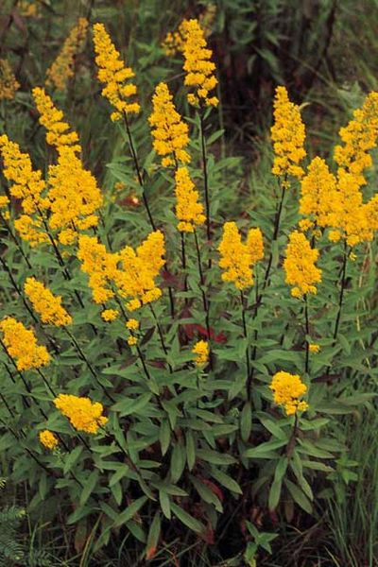
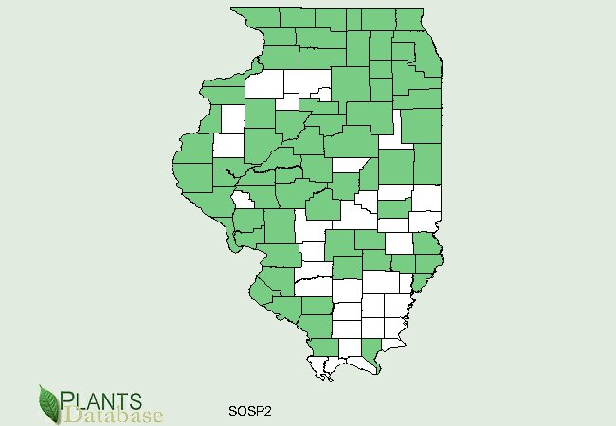
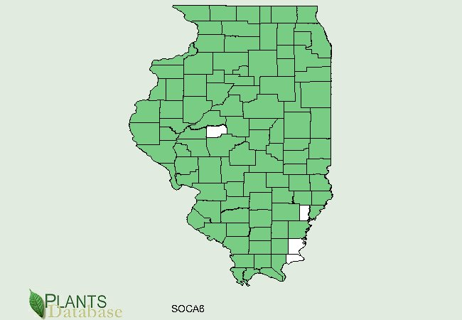
Solidago speciosa C = 7 Prairie, savanna
Solidago canadensis
C = 0
Everywhere
Notes:
Which species is more Conservative?

Slide 11
Species Conservatism is…?
Notes:
Species tendency/likelihood to being found in remnant , pristine, undegraded habitat---- which is a direct result of its tolerance for human degradation/disturbance levels
In many ways it is simply an estimated measure of specie sensitivity to human disturbance

Slide 12
Species Conservatism IS NOT*
Phylogeny (closely related species)
Successional status/habitat maturity (habitat stability)
Species rarity or range (cosmopolitan, widespread, restricted)Plant traits/life-history/functional groups, (r/K),
longevity, fecundity, dispersal, leaf traits, mode of reproduction
Specialist vs. generalist
Habitat Breadth/Habitat specificity/Ecological amplitude-- # or range of habitats
Environmental niche breadth
Habitat fidelity or faithfulness– types of habitat
Notes:
Actual words plucked from the literature used (erroneously) to define FQA
Once they enter the literature they are perpetuated and cause confusion & misuse
Reasons that I assume this happens is:
--People have added their personal interpretation of what they think Species Conservatism is, or what they think it should be.
--People want FQA to “feel more scientific” so they draw from their background training in Plant Ecology or Biology and they try and associate these existing theories/concepts/properties with species Conservatism. -------
--Although in most cases Swink & Wilhelm EXPLICITLY said they were trying to avoid most of these associations.
In every one of the bullet points above, there are species with exceptions to these definition criteria. So they cannot be used as a definition. Lets take species rarity as an example……..

Slide 13
Species Conservatism IS NOT*
Phylogeny
Plant traits/life-history/functional groups, (r/K),
longevity, fecundity, dispersal, leaf traits, mode of reproduction
Specialist vs. generalist
Successional status/habitat maturity (habitat stability)
Species rarity or range (cosmopolitan, widespread, restricted)
Habitat Breadth/Habitat specificity/Ecological amplitude- the # or range of habitats
Environmental niche breadth
Habitat fidelity or faithfulness– the types of habitat
Notes:
*Even though these species C-values may be highly correlated with these properties, they are not one and the same….

Slide 14
“All too frequently, areas where legally protected species are absent are considered expendable under current formal environmental evaluations. It is precisely because Floristic Quality Assessment is not based on species rarity or legal status that it is a useful tool for assessing the natural quality of an area. ”
Herman et al. 2001
Notes:
Conservatism was created specifically without considering rarity….why?

Slide 15
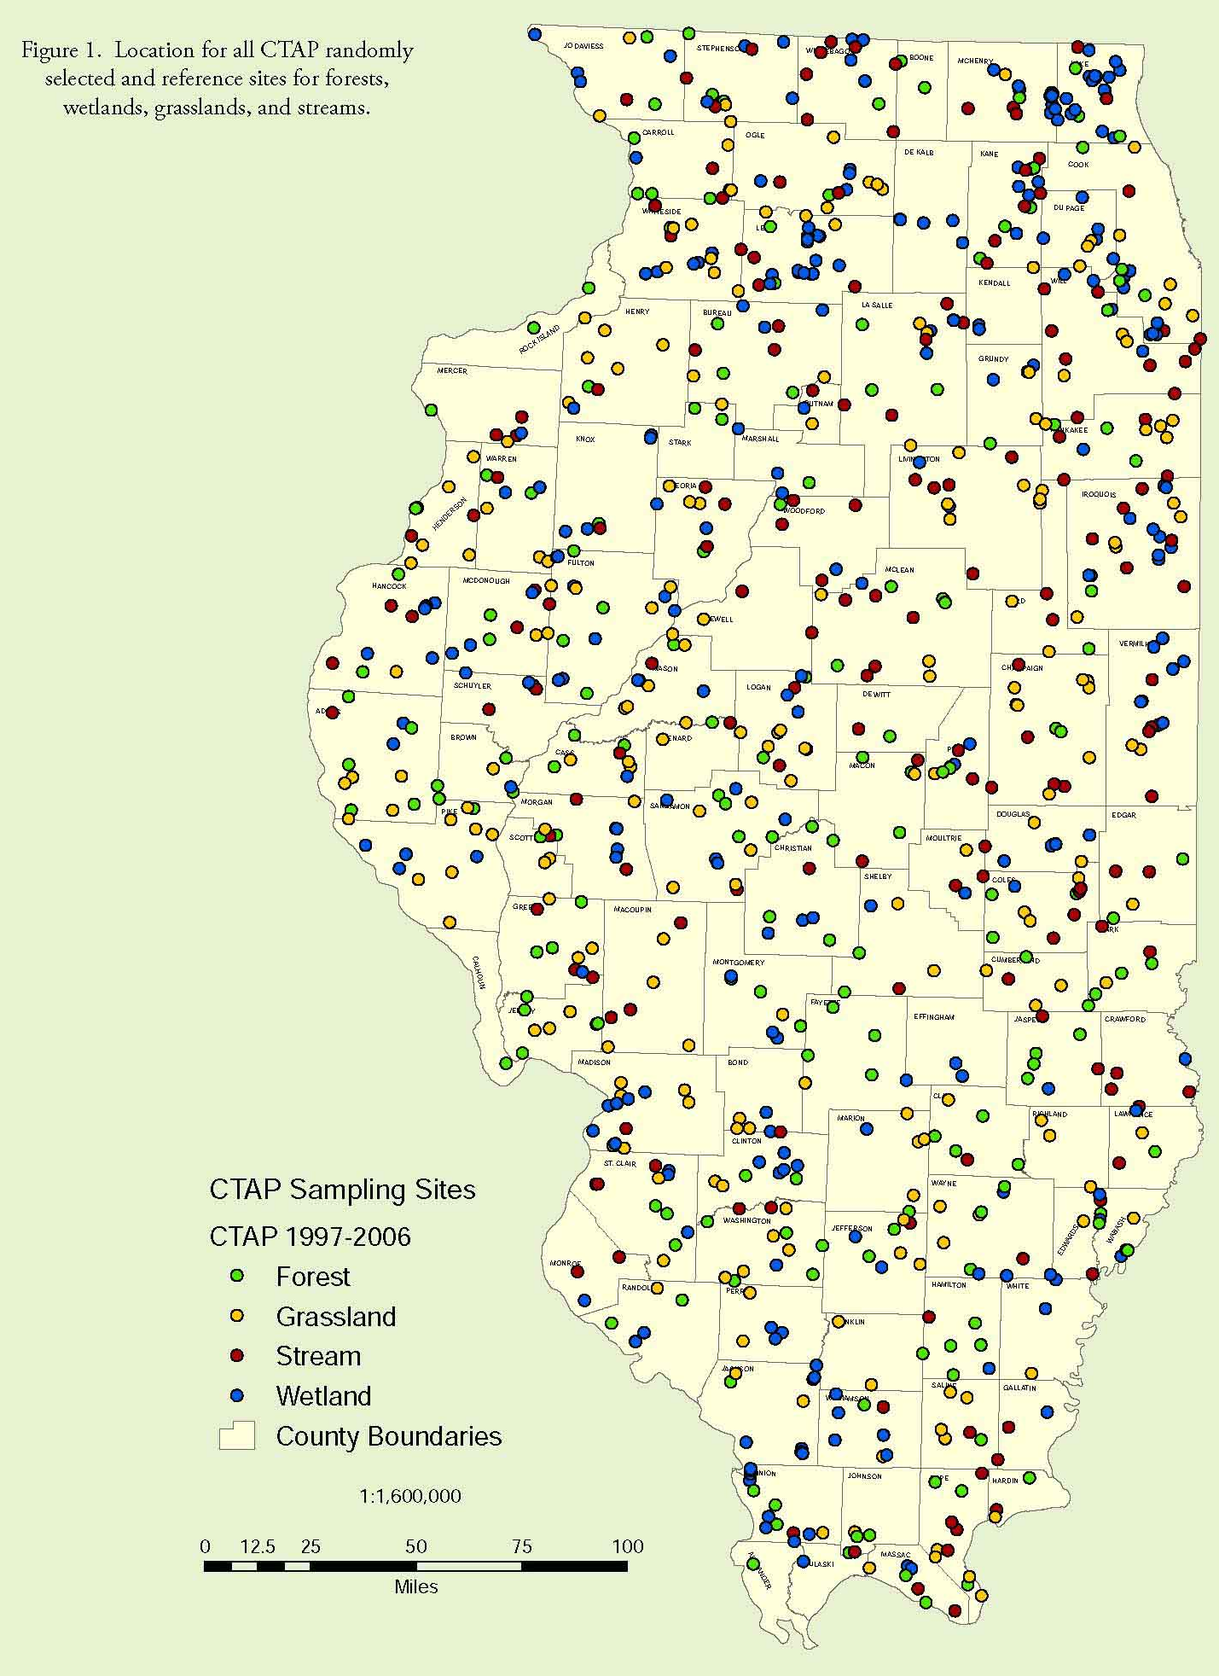
Rare & Protected
3,500 plants
2,500 native
340 T & E’s
75 threatened
265 endangered
1 threatened (Cyperus greyoides)
Notes:
Protected species are just too rare to be very useful, of all these sites sampled only one Threatened or Endangered species was found

Slide 16
Species Conservatism IS NOT*
Illinois species’ C-values and Range (# counties occur in)
N = 1987 (natives only)
p < 0.0001, r²_{adj} = 0.50
Spyreas, in prep
Notes:
*** Even though they may be highly correlated with these individual properties, Conservatism and rarity are not one and the same
Look at the 0-4 species, the most common values, essentially there is no relationship there, it’s a straight horizontal line
Even for the more conservative species (7-10) there are exceptions, e.g., Sporolobolis heterolepsis is in just about every county

Slide 17
Species C-values are Accurate
Spearman rank correlation (ρ) = 0.55
Matthews, Spyreas, Long, 2015
Notes:
Testing Species C-values– testing expert botanists values to see if they are meaningful
We see that relatively seem to be mis-assigned. Conservative species con-occur with one another.

Slide 18
Site Level Metrics Work Very Well
Mean C vs. ranked anthropogenic disturbance levels of 47 emergent wetlands in Illinois
Explained variation 60-90%
Spyreas, in prep
Notes:
At the same time site level FQA metrics (e.g., Mean C) works very well.
Many different anthropogenic disturbances that may degrade a site, need to be measured by many different species to encapsulate them all
A few horribly degraded sites throw of the r square here, on the left side of the graph.
Many others studies exist show even higher correlations than this one

Slide 19
Floristic Quality is Floristic Quality
** P< 0.0001, * P<0.001
Spyreas, in prep
Notes:
Across Illinois Habitats Mean C
Although Mean C is clearly well correlated with native diversity or habitat invadedness, etc.
FQA metrics clearly measure unique & different information compared to these other measures (diversity, exotics, etc)
We can envision sites with HIGH NATIVE FLORISTIC QUALITY – undegraded biologically but with low diversity. Makes sense.

Slide 20
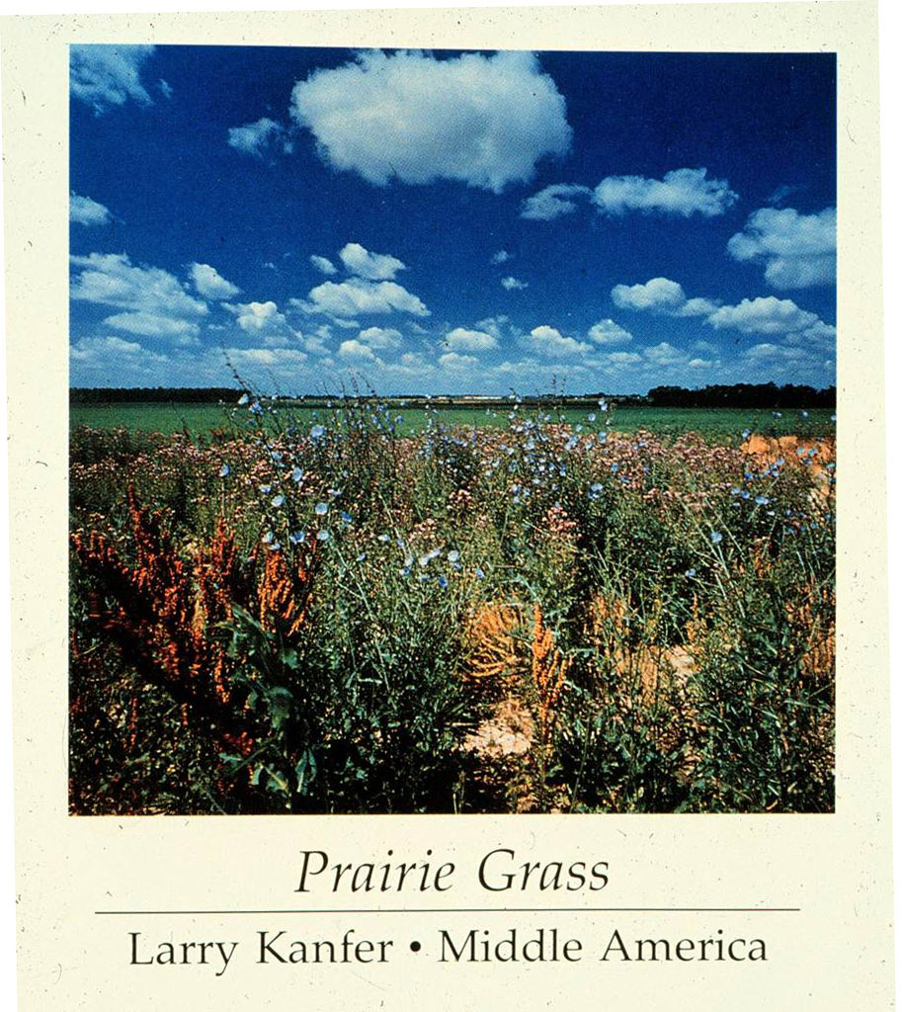
Notes:
So despite what this very popular photography book titled “Middle America” is trying to tell, this is not prairie grass, nor is this a site of any native Floristic Quality

Slide 21
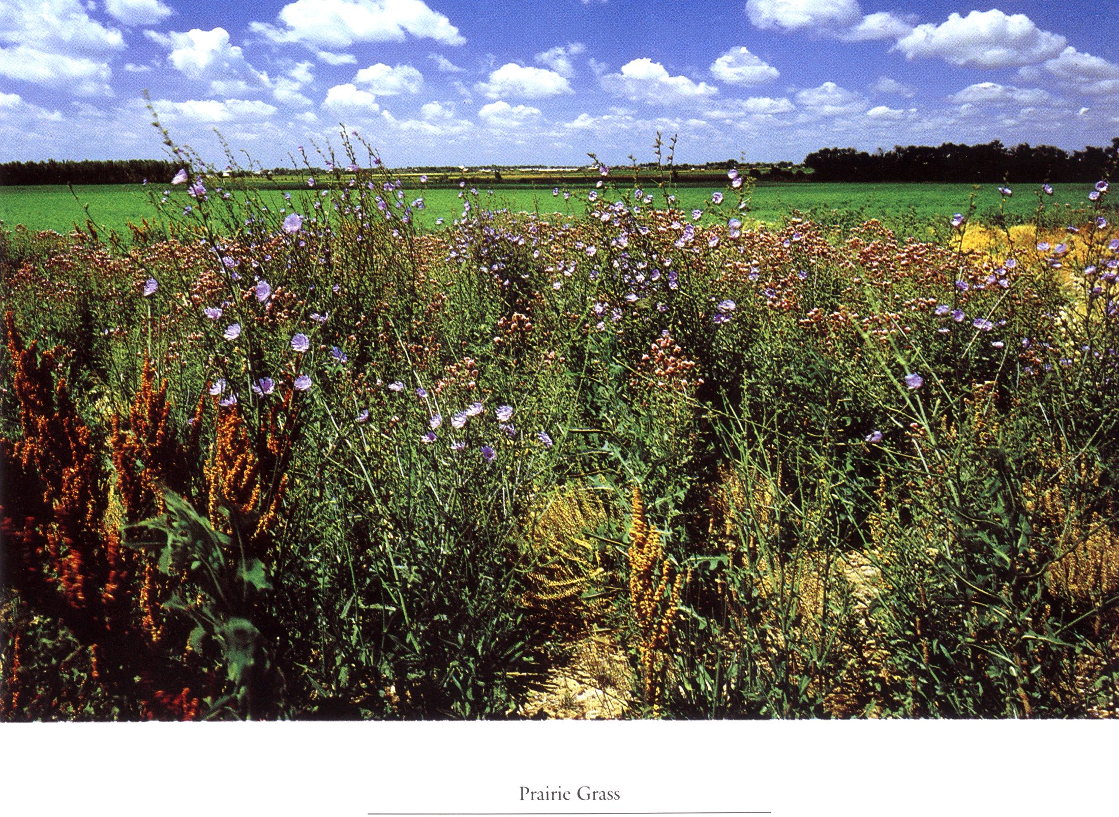
Glycine max (soybean)
China
(Chickory)
Europe-Asia
Cirsium arvense (field thistle) Europe-Asia
Mean C = 0
FQI = 0
Rumex crispus (curly dock) Europe-Asia
Barbarea vulgaris (bittercress) Europe-Asia
Lactuca serriola (prickly lettuce) Europe-Asia

Slide 22
Terminology = DANGER!!
Use the terms religiously and no others
Floristic Quality Assessment (FQA)
Coefficient of Conservatism (C of C, or C, or CC)
Mean C
Floristic Quality Index (FQI, or I)
Notes:
Just as with FQA definitions, dealing with Terminology warrants caution
-- FQA’s Original creators Swink & Wilhelm have revised and refined names over time but, as of their 1994 book Plants of the Chicago Regtion– They ARE NOW SET!!
--Unfortunately, new users have wanted to reinterpret and put their own stamp on FQA, and they have used their own names
--People have added to or interpreted Species Conservatism to what they think it is.
Once published, these new, erroneous terms have proliferated perpetuation and mutated thanks to the Telephone Effect

Slide 23
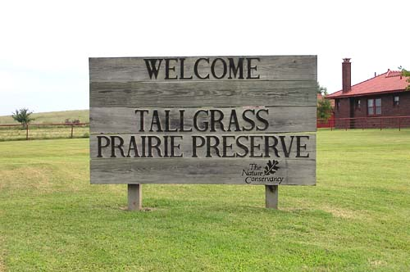
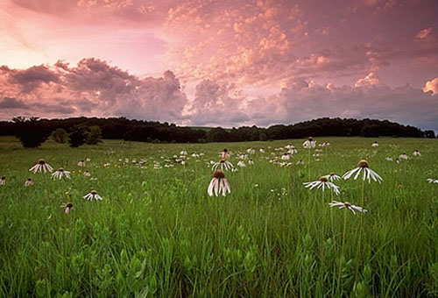
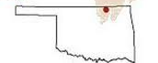
Sampling & Methods Considerations
Notes:
Originally FQA was calculated using the flora of a whole site, but now often calculated using plots, quadrats (site sub-sampling).
Standardization of sampling intensity and plot sizes– consistency (scientific & repeatable) and time is often not possible
Create site FQA values from all kinds of different sites sampled in all kinds of different ways.
How consistent do we have to be in site sampling to produce comparable FQA values?

Slide 24
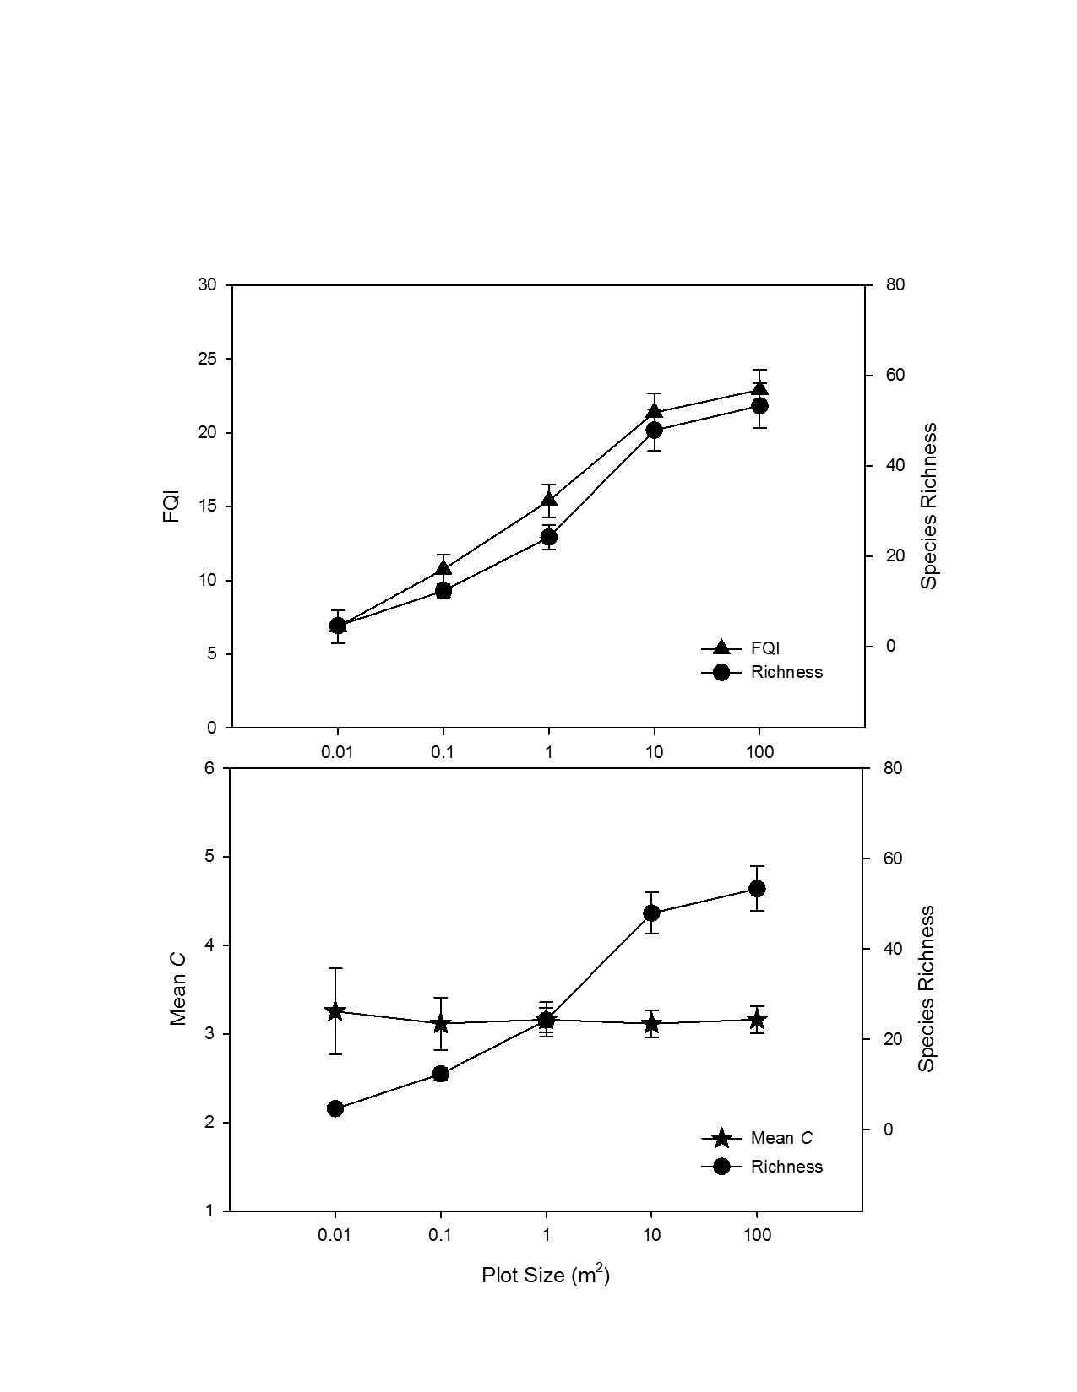
Area Effects
Homogenous relatively undisturbed tallgrass prairie
Continuously sample 20 plots over 11 years by the same botanist
Nested plots
Spyreas & Beas, in prep
Notes:
How does the size of the sampled area effect FQA values?

Slide 25
Species will be Missed
Time of year
Time of day
Botanist
Size of plot/quadrat
Vegetation type/density
Notes:
Species will be missed during sampling, how does this affect FQA values?

Slide 26
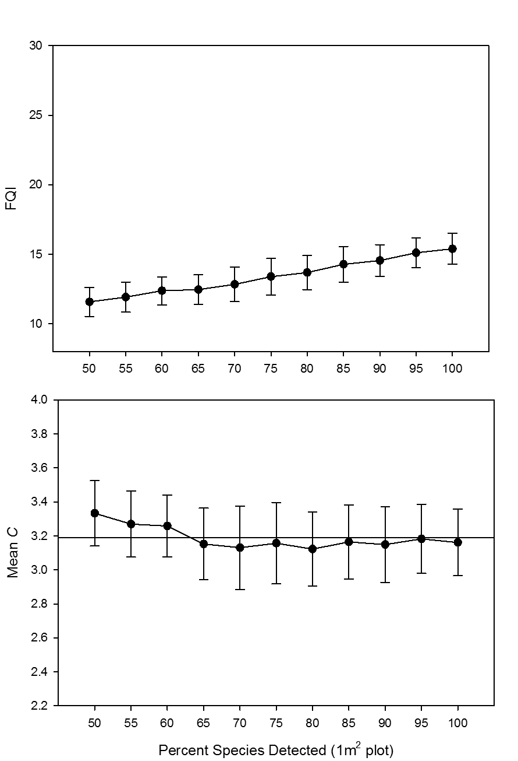
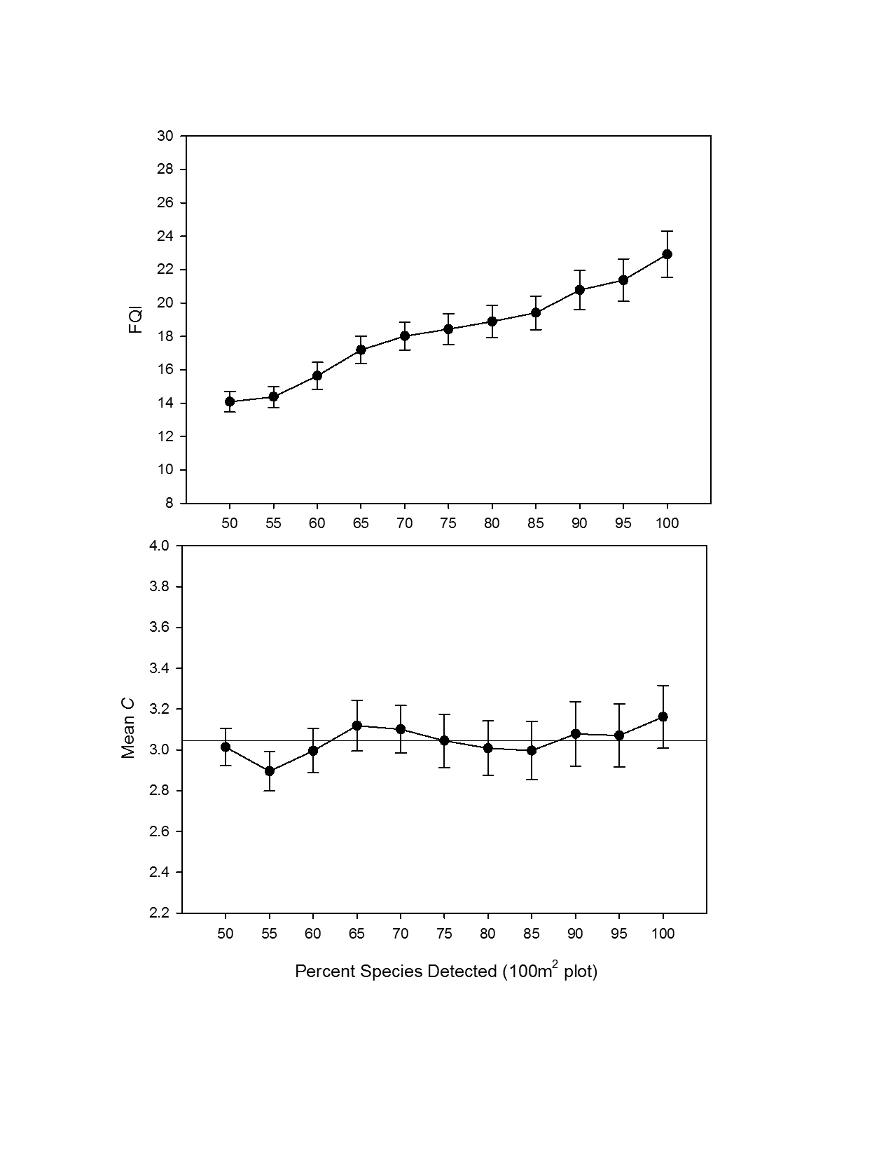
Species Detectability
Spyreas & Beas, in prep
Notes:
What percent of the species in a plot do you have to miss before Mean C breaks down, is no long accurate?

Slide 27
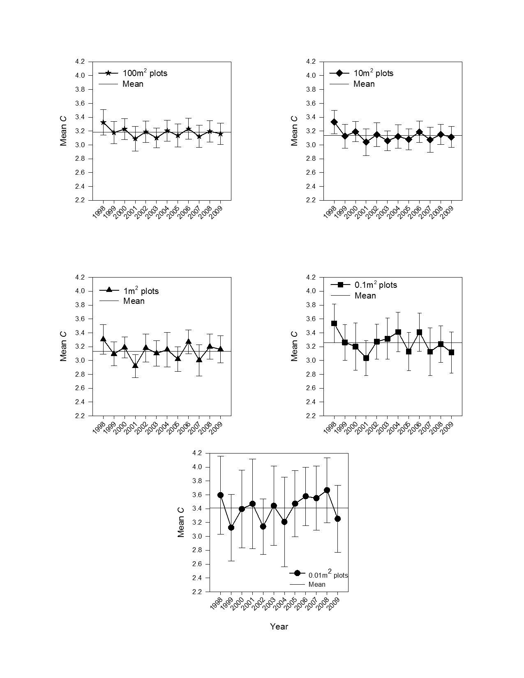
Year Effects
Mean C
Climax habitats
Natural, interannual cycles & variation should not change scores, if there is no human disturbance
Drought, fire, bison, grazing affects species apparency
Spyreas & Beas, in prep
Notes:
Are values so variable across years that they are no longer accurate?

Slide 28
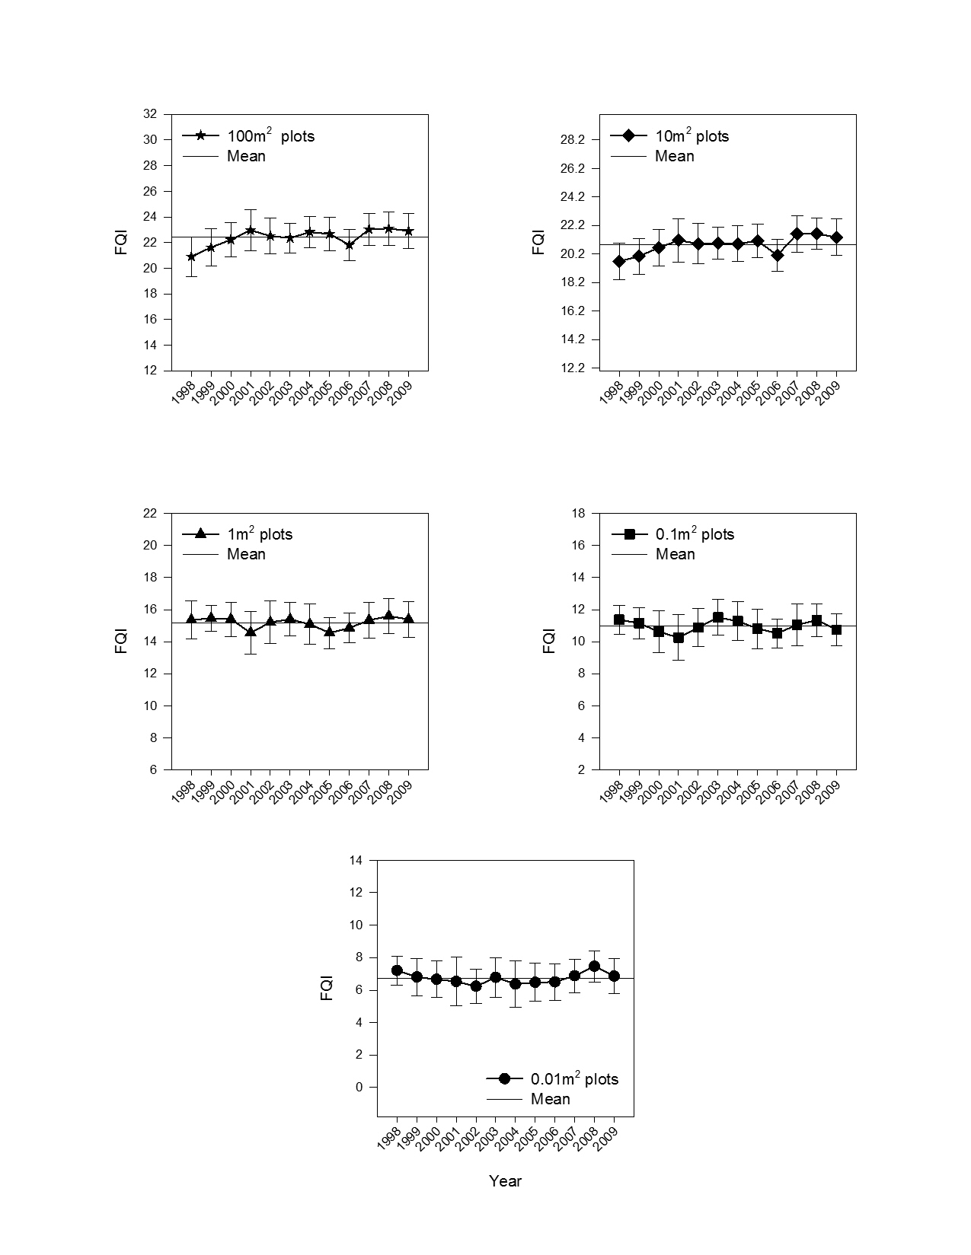
Year Effects
FQI
Spyreas & Beas, in prep

Slide 29
Sampling & Methods Considerations
Species misidentification
Within year (seasonal) variability
Non-native species
Abundance
Notes:
Further study needed on this topic

Slide 30
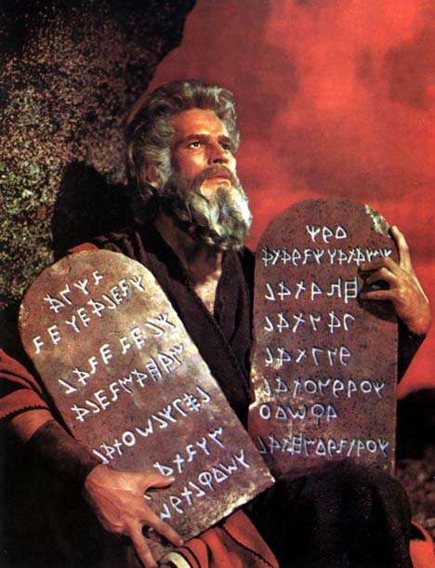
Analysis & Score Comparison
“This ordinance requires the protection of wetlands in a development in such a way that the Floristic Quality Index (FQI) …calculated two years after development cannot be more than two points less than the original FQI. If the wetland has a lower FQI, the developer must provide wetland mitigation for the impacted wetland”
Chu and Molano-Flores 2013
Notes:
We have these site or plot values what do they mean and what can we do with them?
The levels of influence that these single numbers has is enormous, and it assumes a tremendous level of precision

Slide 31
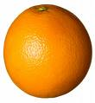
Comparing Scores
Assumed that a score tells us with a high level of precision about a site Floristic Quality→ biological degradation, human disturbance levels
A site FQI score 20 or Mean C = 4 anywhere means the same thing
Region
Vegetation type
Laws & agency policies assume that a score in place & habitat means the same as another

Slide 32
Floristic Quality & Vegetation types
Random wetlands and forests across Illinois
Reference grassland, wetland, or forest
Notes:
The overall goal of answering does a 20 mean the same in a wetland and a forest?
Reference site are especially useful because they tell what the highest possible value is for a habitat and what the inherent/natural variation across habitat types might be

Slide 33
Vegetation Types
Random sites
Site Mean C
Spyreas, in prep
Notes:
Habitat types clearly differ in their Floristic Quality across the state--- which we might take to assume that habitat types are not equivalent
Remember we cant compare fqi and richness across different habitats, because they are sampled differently

Slide 34
Reference Site Mean C
Vegetation Types
Spyreas, in prep
Notes:
When we look at sites selected as high quality ref sites
A different story appears… what does it mean?
Does this mean that comparing wetland values to forests are no-no?
Are we comparing apples to oranges? because forests are just inherently higher in Floristic Quality (just because of their natural ecology or whatever)?

Slide 35
Distribution of Mean C scores
light grey columns-- randomly selected sites
dark gray column-- reference sites
Spyreas, in prep
Notes:
Lets look at the distribution of all these values
Scores telling us that wetland are more disturbed an average across the state
Habitat differences not a cause for concern

Slide 36
Random & reference Upland vs floodplain Mean C
Vegetation Types
Spyreas, in prep
Notes:
Mean C one habitat that stands out is that floodplain forest may inherently score a little lower than other habitats (all else being equal– given similar human disturbance levels)
Marsh seemed lower than other habitats in FQI because it seemed to have lower richness
However, detangling what is the highest level that a habitat will score in pristine condition versus what are simply just human disturbance artifacts is very difficult
Bottom line-- beware that comparing scores from SOME habitats may vary A LITTLE for reasons that aren’t related to Human Disturbance levels– but these seem to be pretty small effects
Upland and floodplain forests may be a more simple case where both ference and random CTAP forests may differ in Mean C suggesting that floodplain forest is simply less capable of achieving higher Floristic Quality values (ie not because it is more disturbed by human). And its comparison with other habitat types may be biased
But trends for FQI values did not show a consistent pattern across these two habitat types

Slide 37
Floristic Quality & Region
All sites
Mean C by latitude
r²_{adj} = 0.09
p < 0.001
Spyreas, in prep

Slide 38
Floristic Quality & Vegetation types
Forests
Mean C
r²_{adj} = 0.29, p < 0.001
FQI
r²_{adj} = 0.25, p < 0.001
Richness
r²_{adj} = 0.08, p < 0.001
Spyreas, in prep

Slide 39
Floristic Quality & Vegetation types
Wetlands
Mean C
r²_{adj} = 0.03, p = 0.03
Quadratic- r²_{adj} = 0.11, p < 0.001
FQI
r²_{adj} = 0.00, p = 0. 0.36
Quadratic r²_{adj} =0.06 p = 0.002
Spyreas, in prep

Slide 40
Plant Richness North America
Qian 1998
Notes:
As with the law of specie richness in ECOLOGY, are FQA by latitude effects ecological laws?
States as big as south and north dakota florida Illinois must be comparable from north to south– a problem?

Slide 41
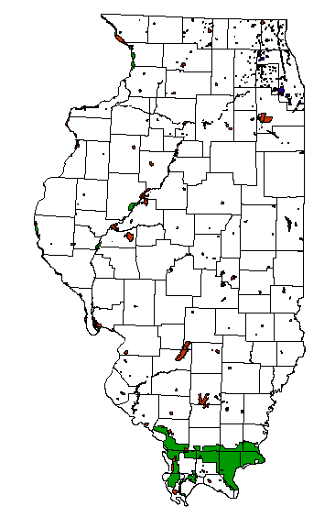
Protected Wetlands & Public Land
Notes:
Yet another artifact of human disturbance legacies as opposed to inherent characteristics of FQA scores?

Slide 42
Regions and Vegetation Types
Among vegetation-types or across regions natural variation– invalidate score comparisons?
Floodplain forest Mean C, Marsh FQI/richness
North to south forest
Low explained variation & effect size compared to human disturbance------------→
Spyreas & Matthews, in prep
Notes:
Anytime scores are compared across habitat types users must be aware that they could potentially be confounded
What does confounded mean? Rather than reflecting biological degradation, conservation value, etc. FQA values could partially be reflecting different habitat types/regions of the sites. Think about someone like TNC over or undervaluing certain habitat types, or a study on management or invasive species attributing results to study treatments rather than simply habitat type bias, or a law that applies a FQI threshold of 20 to any site equally.
Where, for example, differences in site scores could be attributable to a habitat-type’s inherent ecological setting rather than its conservation value and anthropogenic degradation levels.

Slide 43
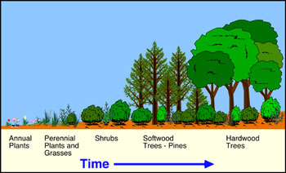
Time & Floristic Quality
High Floristic Quality sites has been characterized with respect to site defined:
“mature”
“late-successional”
“climax”
“successionally-stable”
Simple & predictable increase over time?
Notes:
A final thing to think about when comparing scores with one another
Time (or more specifically the age of the site)

Slide 44
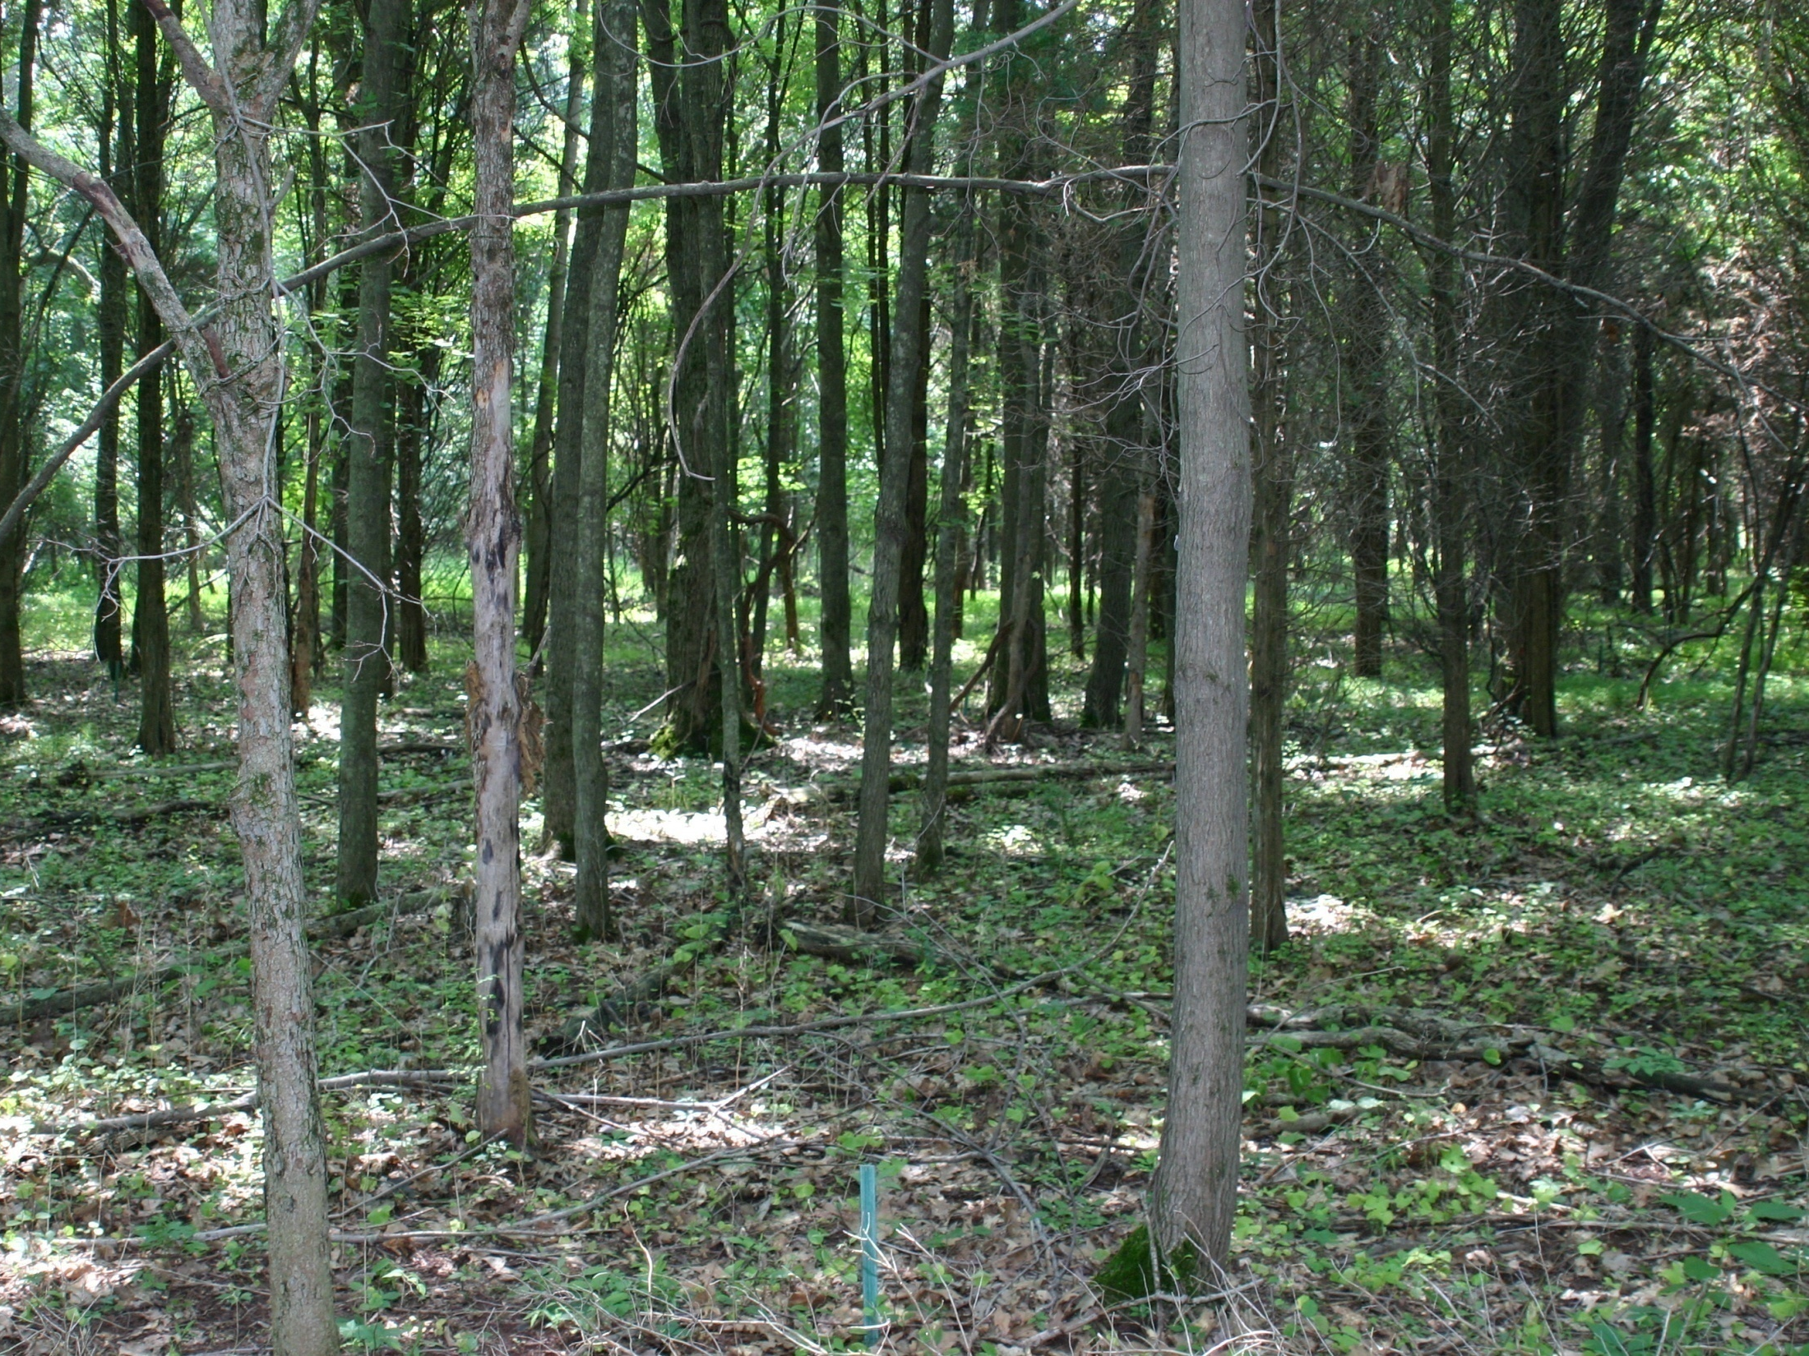
Buell-Small Succession (BSS) Study Site
A 50+ yr successional study (New Jersey)
10 fields
No disturbances, no management
Notes:
With the question All else being equal– how predictable do FQA scores increase over time?

Slide 45
Spyreas et al. 2012, Journal of Applied Ecology
Notes:
All else being equal– FQA scores are very predictable over time– all the fields did the same thing– despite having different species in them

Slide 46
Notes:
A complex relationship with site age (time since human disturbance) that seems to generally increase, but is curvilinear even if its pretty consistent and predictable
Probably shouldn’t define Floristic Quality in simple succession terms
“mature”
“late-successional”
“climax”
“successionally-stable”

Slide 47
Forest Succession & Species Richness
Peet & Christensen 1988
Notes:
Species Richness in forests has received lots of study and data
This needs to be done for FQA in other habitats and over longer timeframes

Slide 48
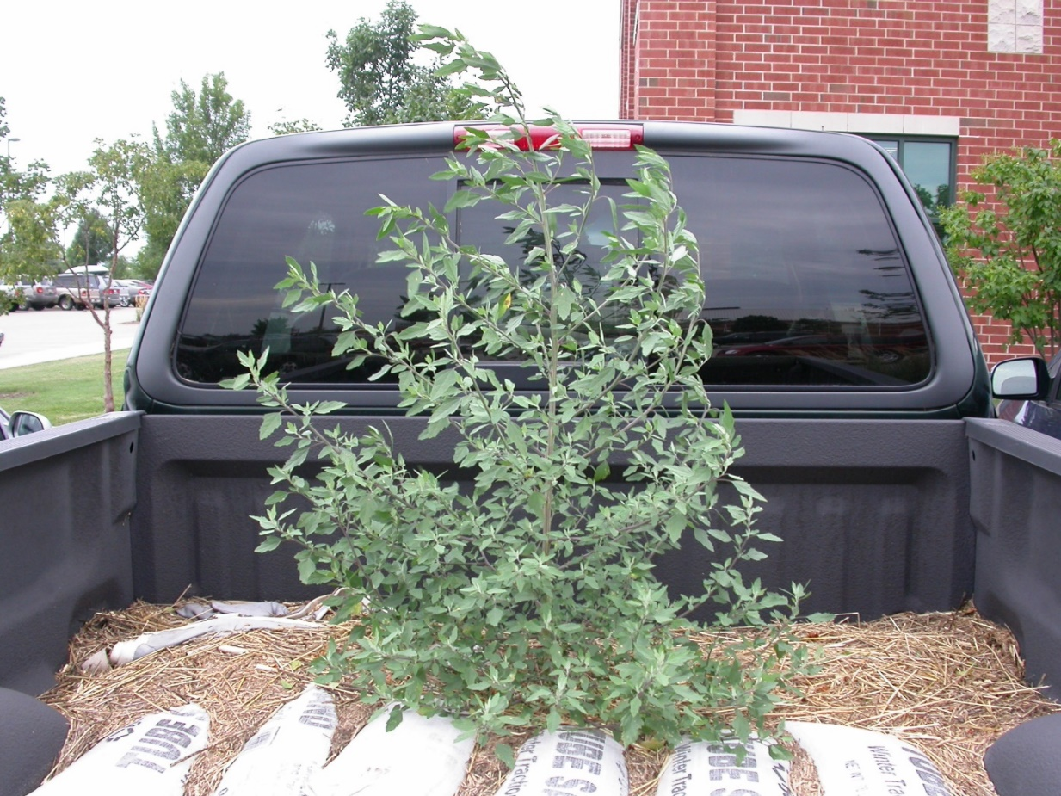

Slide 49
Mean C = 0
FQI = 0

Slide 50
Reminders, Do’s, and Don’ts
Terms, metrics, formulas, abbreviations
Keep it simple & “Original” “Standard” texts
Definitions
Conservatism = occurrences
Floristic Quality values = disturbance/degradation
Natural vs. Anthropogenic disturbance
Record & Report methods
(sample intensity, sample layout- whole site or quadrat, ecotones, sample date, metric calculation, exotic species, etc.)
Mean C vs. FQI/Richness- sample area size, sample intensity, vegetation type……
Do not compare scores among states
Comparing scores different ages (successional areas)– plot treatments
Notes:
FQA is extremely powerful and useful
The top mistakes I see by FQA users and in published literature
A lot of this is just basic vegetation or sampling stuff that should be thought about with any plant/vegetation ecology study

Slide 51
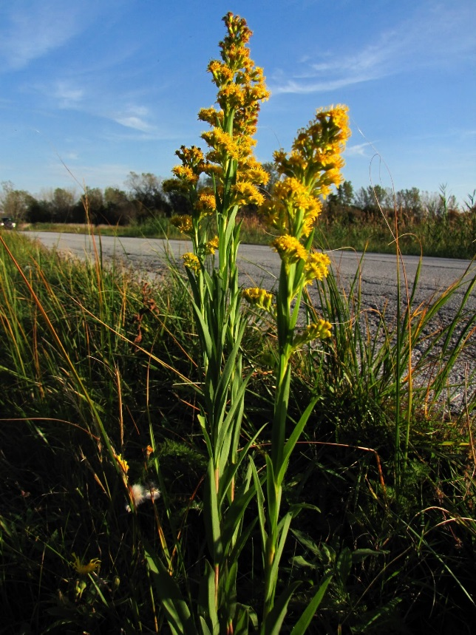
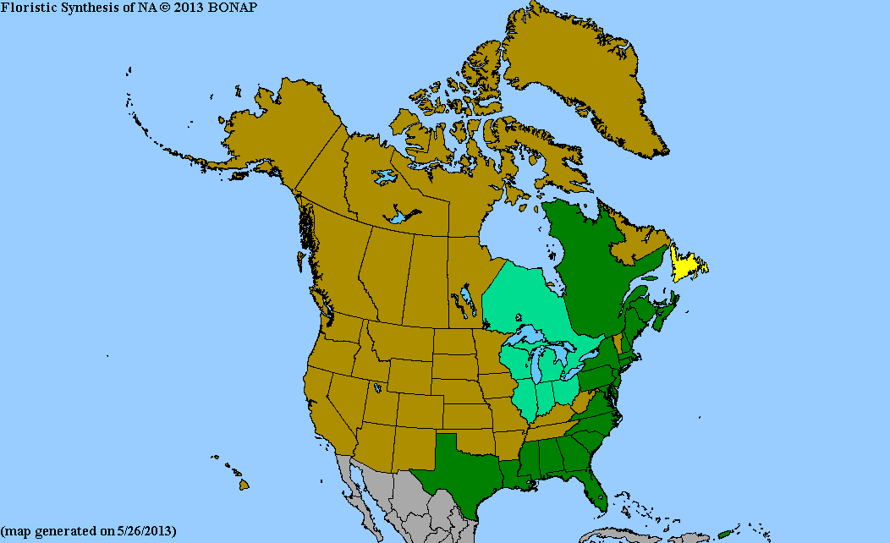
Unknowns
Vegetation type?
specific habitats- floodplain forests, marsh,
pristine sites
Region?
large latitudinal gradient vs within Chicagoland
Intra-annual variation?- within calendar year
Beware of recreations, restorations, and novel habitats
Site FQA values
Species C-values

Slide 53
Acknowledgements
Many CTAP people
T.J. Benson, Scott Chiavacci, Brenda Molano-Flores, Loy R. Phillippe, John Ebinger, Paul Marcum, Jeff Matthews, Dan Busemeyer, Mike Wallace, Michael Palmer (Oklahoma State), many others
Pictures
Michael Jeffords
The internet (apologies if I didn’t credit your image)
Spyreas@Illinois.edu

